Slide 1
2021
Health Insurance
Open Enrollment
Notes:
Hyperlinks have been inserted to supplement this program.
Please visit Sourcewell’s Health Insurance pool webpage for additional information to help with you open enrollment meetings.
https://www.sourcewell-mn.gov/services/insurance-employee-benefits/health-insurance-pool

Slide 2

Agenda
  Get a refresher on the basics of health insurance
  Get an overview of your health plan options and
  any changes
  Better understand your coverage and benefits
          Low cost and high value service options
          Resources to help you get and stay well
          Free preventive care
  Learn how Sourcewell’s partners support you
          HealthPartners
          HealthSource Solutions
          Omada
          Progyny
  Know what happens next
  Get a refresher on the basics of health insurance
  Get an overview of your health plan options and any changes
  Better understand your coverage and benefits
  Learn how Sourcewell’s partners support you
  Know what happens next

Slide 3

Who is Sourcewell?
Notes:
Sourcewell is a self-supporting and independently operating government organization that partners with schools, government, and nonprofits to boost student and community success.
We are committed to our members by providing the best service possible and strategically reinvesting in member communities.
Over 150 employees
Based in Staples, MN

Slide 4
About Sourcewell’s MN Health Insurance Pool
Well established pool
Health insurance pool started in 1984
Many public employers across MN benefit
23 member groups (as of 8/1/20)
Competitive rates and rate stability are the primary objectives
Valuable benefits which include robust preventive and wellness benefits
Many public employees benefit
~2300 participating employees, with ~4500 participating members
Employees and retirees from schools, cities, counties, and other government entities

Slide 5
Health pool mission statement
Sourcewell’s health insurance pool is a community of public employers from across Minnesota who are committed to leading their people to the highest possible state of wellness, who leverage the power of cooperative purchasing and risk sharing to optimize the affordability and stability of valuable health plans and related services.
Notes:
Mission Statement
Highlight affordability and stability – tie affordability to RFP results and options. Tie Stability to our renewal offer

Slide 6


Financial mechanisms
Self-funded Pooling of risk
Notes:
The Self Funding Model works to yields our best opportunity for affordability, valuable, and stable health plans.
Advantages of self funding include:
Not Subject to ACA fully insured underwriting rules
Transparency on claims data
No premium tax as in the fully insured market place.
Lower Administrative Fees
Ability to determine premiums, control reserves, retain Rx Drug Rebates, and be creative with other solutions.
Make values based decisions regarding benefits and coverage. This allows to us ensure member employees have a health plan that works for them.
Our pool gets keep underwriting profits – but conversely needs to fund for underwriting losses in our reserves.
Pooling of Risk – Better Together to provide stability
The general health insurance market place is and has been very volatile as it applies to premium increases: AND benefit stability. In order to reduce premium increases employers and insurance companies have been forced to limit or remove benefits. By treating our population as one pool, one group, we can level out the volatility for both premiums and benefits.

Slide 7

Self-funding strategies
Administration
Stop loss insurance
Health and Rx claims
Notes:
This a graphic meant to represent $1 of premium. Roughly 5% is the cost for health partners to administer and run their portion of the pool. Approximately 5% is the insurance that we purchase. However, claims are the driving factor behind premiums. 90% of a premium dollar is used to pay for healthcare services and prescription drugs – what are we doing to address this? How do we address “affordability” when we understand how the dollar is generated?

Slide 8


Self-funding strategies
Wellness programs
Biometric screening
Top Value rewards program
Omada
Progyny
HealthPartners
Notes:
Curtailing future claims and lowering current claims is the reason why we implement these plans – and to enrich the lives of those we serve – employees and their families.
But we need engagement – we need your help to achieve this

Slide 9
Pooling for stability
10 Year Renewal History
Notes:
Primary financial goal of the pool is to provide stable, predictable in order to support your budget planning and negotiations. Medical trend over this time period didn’t look much different than our 6.84% average increases over this time period, but you will note that 6 of the past 10 years we were in a position to offer either no increase or a decrease to much of our membership.

Slide 10

Health pool partners
HealthPartners
Administers medical and prescription claims for the pool
Provides access to valuable network of providers and programs
Protects pool and its members against the risk of very large claims
HealthSource Solutions
Administers WellRight wellness portal (website and mobile)
Assists your workplace leaders in developing a unique culture of wellness
Tracks and reports wellness activity that yields incentives to members
Omada
Industry-leading program to assess and assist pre-diabetics with weight loss
Progyny
Infertility benefits to help yield successful pregnancies

Slide 11

Health Insurance 101

Slide 12
Health insurance terms and definitions
“Health”
Health care (primarily diagnosis, treatment, and prescriptions)
Prevention (services to prevent or early detection of illness)
Wellness (services to assist in improving/maintaining well-being)
“Insurance”
Pooling by many of the risk that a few will experience very high costs
Not all risk needs to be insured; some risk can be self-insured
      Self-insurance by members includes deductibles, health savings, etc.
Self-insurance by groups can save money but puts the group at risk
      Risk can be mitigated by joining other groups in a pool (like Sourcewell’s)
      Many programs are available to help manage health and care costs and thus reduce the overall risk

Slide 13
Health insurance terms and definitions
Deductible
Amount member owes before health plan pays
Coinsurance
Percentage member owes after meeting the deductible (i.e. 20%)
Copay
Fixed amount member owes, and deductible may not apply (i.e. $50 Rx)
Out-of-pocket Maximum
Maximum owed by member when totaling deductible, coinsurance, copays
Preventive
Definitions vary by plan, but usually are provided at no charge to member

Slide 14
Health insurance terms and definitions
Health Savings Accounts
Tax advantaged account owned by member, funded by employer or member
VEBA or Health Reimbursement Arrangement
Tax advantaged account owned by employer, funded by employer for member
Provider network
Medical providers who have agreed to care standards and discounted fees
Out-of-network
Member pays higher deductible and may get billed additional fees by provider
Prescription formulary list
Prescriptions, both brand and generic, discounted for affordable access
Non-formulary
Member pays more, perhaps full cost, of prescriptions not on approved list

Slide 15
Key elements of valuable health plans
Employee Assistance Program
Free telephonic and online help with virtually any issue causing stress
Wellness Program
Activities to educate and motivate members to engage in healthy living
Case and Disease Management Programs
Free assistance from professionals who can help members get quality care
Convenient Care
Low cost access to online care, mobile-access, and minute-clinics
Nurse Line
Trained professionals to assist members with care decision-making
Member Service Support
Help navigating, understanding, or accessing any aspect of the health plan

Slide 16


Where can I find more information?
Go to Sourcewell’s webpage at sourcewell-mn.gov
Services & Programs tab
Select
‘Insurance Programs’ from the menu options
Notes:
Sourcewell has created a web page specifically for the individuals on the health plan. These next slides show how to navigate to the employee resources related to the Sourcewell Health Plan.

Slide 17
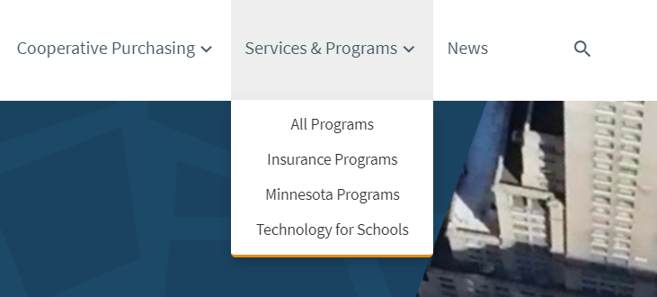
Where can I find more information?
Go to Sourcewell’s webpage at sourcewell-mn.gov
Click the
“Services & Programs” tab
Select
“Insurance Programs”
from the menu options
Notes:
Sourcewell has created a web page specifically for the individuals on the health plan. These next slides show how to navigate to the employee resources related to the Sourcewell Health Plan.

Slide 18
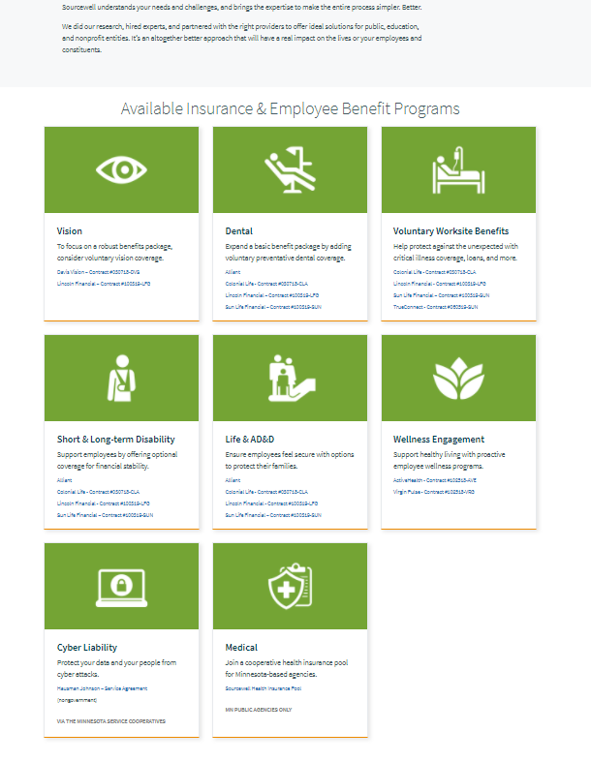

Where can I find more information? cont.
Scroll down to the “Available Insurance & Employee Benefits Programs”
Find the “Medical” section
Click “Sourcewell Health Insurance Pool”

Slide 19
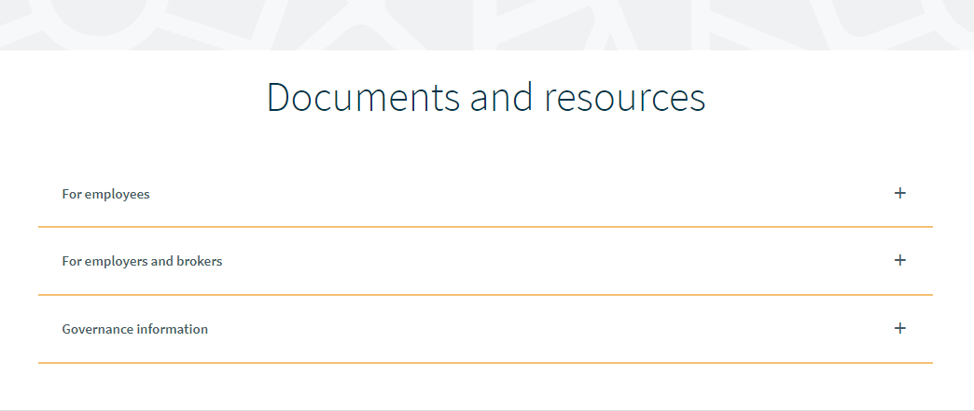
Where can I find more information? cont.
Scroll down to the “Documents and resources” section
Click the + symbol to expand the “For employees” section

Slide 20
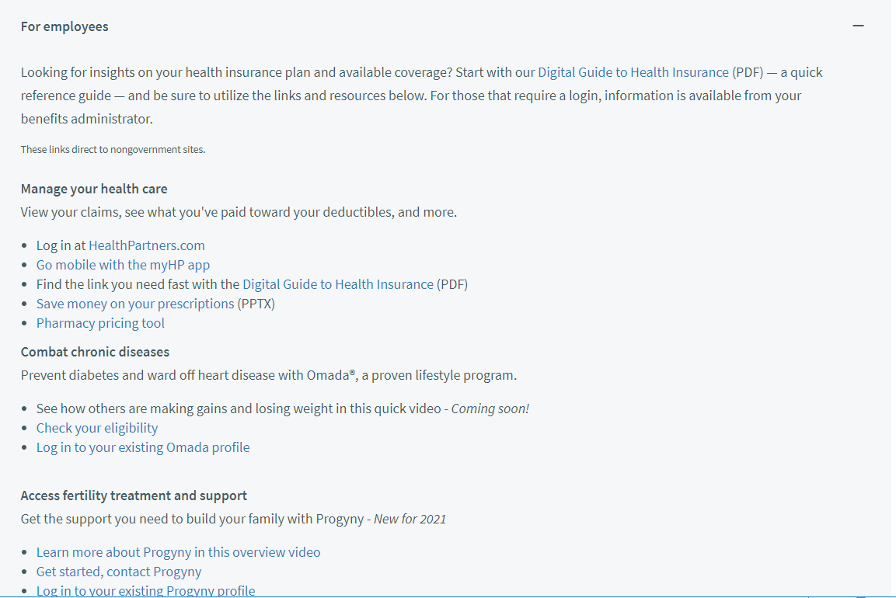
Where can I find more information? cont.
In addition to this, families can log into the
Wellright Platform; learn about telehealth options
Seek care from providers such as Virtuwell
Find mental health support with
Dr. OnDemand
Access the Employee Assistance Program
Notes:
In addition to what is displayed on this slide, employees and their families can log into the Wellright Platform; learn about telehealth options and seek care from providers such as Virtuwell, and Dr. OnDemand; find mental health support, and access the Employee Assistance Program.

Slide 21
About your health plan
HealthPartners

Slide 22
Summary of changes effective Jan. 1, 2021
    Progyny infertility benefits
    Top Value gift card rewards
    Wellbeats replacing Frequent Fitness
    ActiveandFit and Global Fit gym discounts
    Smart plan 5, 6, 7 indexed
    PSA tests no longer covered as preventive & not advisable
    Medications for PrEP covered as preventive if for HIV

Slide 23
Reminders for 2020
    One free telehealth visit to any provider, including:
      Your choice of clinic
      (if telehealth offered)
      Telehealth providers
      (Virtuwell or Doctor on Demand)
    Earn your wellness points for 2020 and earn money!
    COVID-19 resources:
      All about COVID HealthPartners.com
      To seek free help in getting through what you’re going through HPEAP.com or 866-326-7194 password: sourcewell
      For testing information Virtuwell.com

Slide 24
Replace this slide with your slides or videos from Health Partners

Slide 25
About our
Smart Plans
For anyone electing one of Sourcewell’s Smart Plans

Slide 26


Smart Plans
A way to save time and money while still receiving the best in health care coverage.
By pooling resources and providing consistency of benefits, we can all be better together and achieve stability and affordability when it come to health insurance benefits.

Slide 27
Smart Plans are…
Simple
Four deductible levels available
Coinsurance ranges from 80-100% after deductible
All plans are HSA-qualified and include free coverage for preventative prescriptions
Valuable
Important first-dollar coverage on all plans, including:
Three mental health visits via EAP
On-site biometric screenings and routine physicals
Minimal out-of-pocket expense

Slide 28
Smart Plans are
Rewards
Members can save up to $2,000 and earn up to $1,000 in additional rewards by choosing Top Value providers
Top Value benefits are available for certain procedures when members are able to elect when and where to receive the eligible service
Top Value providers are proven to be high quality and low cost
Generous travel benefits are available to afford traveling to Top Value providers

Slide 29
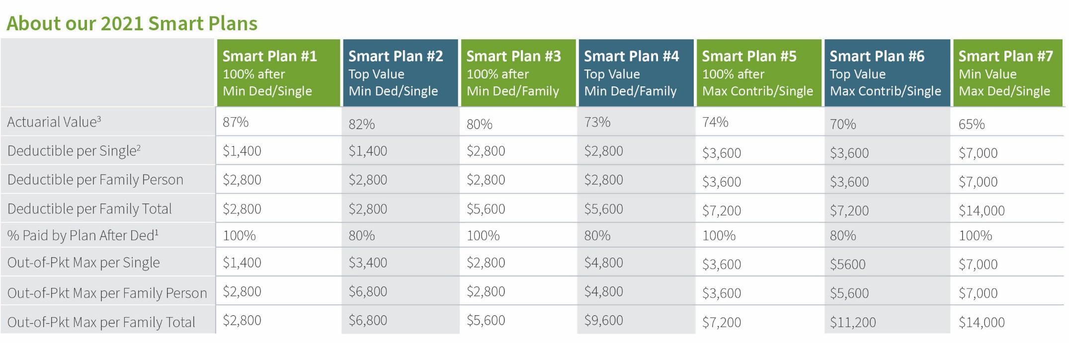
Get smart with our Smart Plans
Choose up to four plans from our seven options
*All plans automatically index annually, please see page 5 for projections.
¹After deductibles on all Smart Plans, the Plan pays 100 percent of the cost of qualifying care received at Top Value providers, as well as provides up to $1,500 of travel benefit when used to see Top Value providers.
²Deductible need not be met first to receive benefits for preventive prescriptions on all Smart Plans; instead, copays of either $0 for generic or $50 for brand-name drugs on the approved list will apply.
³Actuarial values approximate the percentage of claims that are expected to be paid by the plan for a given population, based on applying the scheduled benefits against the claims experience of a large national population. Actuarial values are calculated using the 2021 ACA AV calculator from CMS. Actuarial values will increase significantly with even modest amounts of employer contributions to HSAs, HRAs, or VEBAs. See Sourcewell’s “AVs at Various Contribution Levels” for more information.
Notes:
Highlight the plan options chosen by member employer.

Slide 30

What is the ‘Top care, top value’ program?
You don’t have to sacrifice top care for top value
Facing surgery or a medical procedure?
Top Value plan helps you locate the
best provider at the best value
You’ll receive reimbursements for travel
and accommodations to and from the
Top Value provider
We’ll waive any coinsurance plus you’ll
receive gift cards based on your plan
and procedure
End result: you get the best care and you pay less
Notes:
You don’t have to sacrifice top care for top value
Facing surgery or a medical procedure?
Top Value plan helps you locate the
best provider at the best value
You’l receive reimbursements for travel
and accommodations to and from the
Top Value provider
We’ll waive any coinsurance plus you’ll
receive gift cards based on your plan
and procedure
End result : you get the best care and you pay less

Slide 31


How do I find a top value provider?
Find a top-value location
Visit healthpartners.com and log on to your account
Go to ‘Find Care’ and search by procedure
View the full list of Top Value providers by clicking the box that contains the symbol

Slide 32


Top Value travel benefit
Purpose
Offer affordable access to Top Value providers not available
Total benefit limit
1,500 per surgery at Top Value provider
Minimum distance for reimbursement
Top Value provider must be at least
50 miles from home
Max. lodging reimbursement
$150 per day of lodging as required for prep and surgery at Top Value provider
Transportation type
Economy/coach fare for train, airplane, or bus; car reimbursement is per mile

Slide 33
What are the rewards?
Coinsurance Waived
Even if your Smart Plan normally requires you pay coinsurance after satisfying your deductible, we waive all coinsurance on eligible expenses at
Top Value providers on all of our Smart Plans.
Gift cards
Top Value Providers Procedure Eligible for Top Value Incentive even if member has met their out-of-pocket maximum* | Gift Card Amount Smart Plans 1, 3, 5, 7 100/0 Plans | Gift Card Amount Smart Plans 2, 4, 6 80/20 Plans
Spine Surgery | $1,000 | $500
(Arthroscopic) Shoulder Surgery | $1,000 | $500
Hip Replacement & Revision | $1,000 | $500
Knee Replacement & Revision | $1,000 | $500
Cardiac Ablation | $1,000 | $500
Arthroscopic Knee Surgery | $500 | -
Gallbladder Surgery | $500 | -
Hernia Surgery, Inguinal | $500 | -
Cataract Surgery | $500 | -
Carpal Tunnel Surgery | $200 | -
Rotator Cuff Surgery | $200 | -
Cardiac Catheterization / Angioplasty | $200 | -
Tonsil/Adenoid Surgery | $200 | -
Ear Tubes | $200 | -
*Reward is payable during the first quarter of the calendar year following the year in which the procedure occurs, and is taxable to the member in the year of receipt. This reward does not disqualify a member from contributing to a Health Savings Account. The reward is based on our annual review of data provided from HealthPartners’ informatics team showing the average total savings when these procedures are performed at Top Value providers. The Top Value provider list is updated annually based on both quality and cost data.
Top Value benefits apply only to Smart Plans with Open Access or Perform networks; not available with other network plans.

Slide 34
Preventative prescription drug program
All Smart Plans include robust coverage for preventative prescriptions
No deductible
Generic prescriptions $0 copay
Brand name prescriptions $50 copay
Notes:
Link the preventative Rx list:
https://www.healthpartners.com/ucm/groups/public/@hp/@public/documents/documents/cntrb_029693.pdf

Slide 35
Ways to Save for Medical
Group or Broker input required

Slide 36
Replace this slide with your slides or videos from HSA/VEBA vendor

Slide 37
Other Benefits
(Group or Broker
input required)

Slide 38
Replace this slide with your slides or videos from vendor

Slide 39
Health Plan Support
From HealthPartners

Slide 40
Replace this slide with your slides or videos from HP

Slide 41
Wellness Program
Managed by HealthSource Solutions

Slide 42
2020 – Earn 250 points, get $250!
When? | What? | # of Points
Anytime in 2020 | WellRight health assessment | 50 points
 | Preventive exam | 50 points
 | Omada program completion | 50 points
 | Onsite biometric screening | 50 points
 | Up to 8 annual pool-wide challenges | 15 points each
Quarterly | Up to 5 personal challenges per quarter | 20 points each
 | 4 quarterly pool-wide 30-day challenges | 25 points each
TBD | Group-specific challenges (if any) | TBD

Slide 43

Easy to use and interact
Mobile App
Text Tracking and Reminders
Fitness Device and App Integration
200+ Individual and Team Challenges
Habit based
Holistic

Slide 44
Take steps to get and stay well, and benefit!
Know your numbers
Update the health risk assessment at least annually
Bio-metric screenings
Easy and fun activities
Periodic group challenges
Short courses to learn more about and engage in available services
Wellness fair and flu shot clinic
Select a challenge that best
suits you
Track your activity on the WellRight portal
Online and mobile access
Sync with your devices
Earn points, and get real money (and healthier) for earning
those points!

Slide 45
Pre-diabetic program by Omada

Slide 46

omadahealth.com/sourcewell
Notes:
Omada® is a digital behavior change program that inspires healthy habits you can live with long term. It combines the behavior change science and unwavering support you’ll need to lose weight, keep it off, and help reduce your risk of certain chronic diseases.
Omada includes:
Wireless smart scale to monitor your progress
Professional health coach to keep you on track
Interactive program that adapts to you
Weekly online lessons to educate and inspire
Small group of participants for real-time support
More great news: COVERAGE INFO
Take a 1-minute risk screener to see if you’re eligible: omadahealth.com/EMPLOYERURL

Slide 47

Omada risk screener
+ application
All interested covered employees and covered adult dependents should go to omadahealth.com/sourcewell to complete a 1-minute screener
If you’re at risk, you’re eligible for the program and can apply on the spot
Applying is easy and takes less
than five minutes
47

Slide 48
Infertility Benefits
By Progyny
Notes:
https://vimeo.com/353488643/41135aeb5d

Slide 49




Your Progyny family building benefit
Provided by: Sourcewell
Comprehensive Coverage
Bundled fertility treatment coverage for every unique path to parenthood
Personalized Guidance
Unlimited guidance and support from a dedicated Patient Care Advocate (PCA)
Premier Specialists
Convenient access to the largest national network of fertility experts
To learn more and activate your benefit, call: 833.208.8447

Slide 50
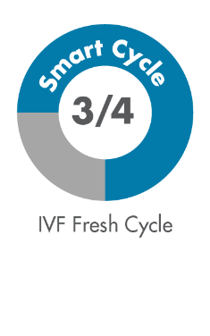
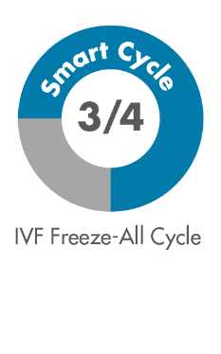
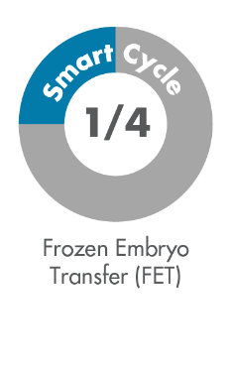
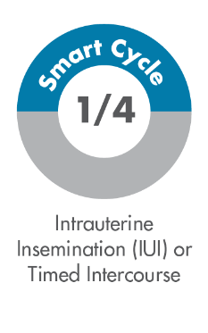

Progyny’s Smart Cycle benefit connects you to leading fertility specialists and allows them to provide the most advanced, effective fertility treatment, the first time—without barriers to treatment—so you can obtain the best chance of achieving a successful pregnancy with the course of treatment that is best for you
Highlights of your coverage include:
1* Smart Cycle
Progyny Rx (Integrated fertility medication coverage)
*You have access to an additional Smart Cycle if your first is not successful.
Note: The person(s) receiving fertility treatment must be enrolled in an eligible medical plan through your employer to have access to the Progyny benefit. Your financial responsibility may include a deductible, co-insurance and out of packet maximum. Please consult with your human resources department to confirm your eligibility.
Common ways to use a Smart Cycle:
To learn more and activate your benefit, call: 833.208.8447

Slide 51
Next Steps
Participating Member or Broker to update

Slide 52

Decisions, forms, deadlines
List all decisions that need to be made, what forms are needed, and when the decisions are due
Provide contact information of those who can be reached for help on various matters
Notes:
This slide is meant to be customized by each participating member group in our pool. They would want to customize this page to their specific open enrollment decisions.

Slide 53
Thank you!

